Slide 1

Predictions in Hospital Mortality
BAIS Baddies Inc.
Lauren Jamison | Brittany Fleury | Natalie McCormick | Sophie Selk
Notes:
#8ca2b5/#82ab7c/#a4a4bc/#b3b4d6

Slide 2
OUTLINE
Background
Business Goal
Data Overview
The impact of cardiac arrests in America and risk-adjusted mortality positive effects on paient outcome
Actionable goal for Hospitals to increase survival rates
Exploratory Analysis
How to predict mortality, a description of hospital dataset, and data preparation process
Methods and Evaluation
Practical charts, correlations , and discoveries in dataset
Synopsis of models used for analysis and evaluations metric
Conclusion and Future Outlook
Summary of dataset analysis and recommendations for hospitals
Notes:
Outline

Slide 3

Background

Slide 4

659,000 people in the United States die of heart attacks
OR
1 in every 4 deaths
One person dies every 19 Seconds in the United States from heart attacks
Notes:
Background
https://www.cdc.gov/heartdisease/facts.htm

Slide 5
The implementation of Risk-Adjusted Mortality decreases the overall mortality rates in Hospitals
Risk-Adjusted Mortality
1.3%
Ability to prioritize patients based on characteristics that predict risk of death
Implement of risk-adjusted mortality caused absolute reduction in mortality
Notes:
Background
https://emj.bmj.com/content/32/3/244

Slide 6
Business Goal
Potential Clients:
Doctor and Hospital Owners
Identify features that take priority of those suffering from heart failure
Apply Risk-Adjusted practice to Hospitals to improve mortality rates
Predict the mortality rate of patients who enter the ICU (Intensive Care Units) due to heart failure to provide doctors with information about what patients they need to prioritize in order to reduce patient-in-house mortality rates
Notes:
Business Goal

Slide 7
Data Mining Goal
Supervised Learning
Training data
Classification
Target Variable
Outcome:
0 = Alive
1 = Death
Mortality after
cardiac arrest
in ICU
Positive or Negative
Outcome of
Mortality
includes both the
input and result
To determine what features are most important in determining a patient's chance of in-house mortality
Notes:
Data Mining Goal

Slide 8

Dataset
Overview
Notes:
Dataset Overview

Slide 9




1,176
Instances
7
Categorical Features
10
Numeric Features
159/1176
= 13.52%
Target Variable %
Notes:
Needs corrected features and target variable

Slide 10

Data Preparation
Notes:
Dataset Overview

Slide 11

Important Features
Missing variables
Random forest of all 50 features to select 15 most important other than ID and Target Variable
Diagnosed and assessed missing variables to create fuller dataset
Transformed Features
Transformed Categorical features as indicator variables
Recoded Features
Numerical features recoded to mean
Categorical features into mode
Deleting all observations with missing
Notes:
Data Preparation

Slide 12

Exploratory Analysis
Notes:
Exploratory Analysis

Slide 13
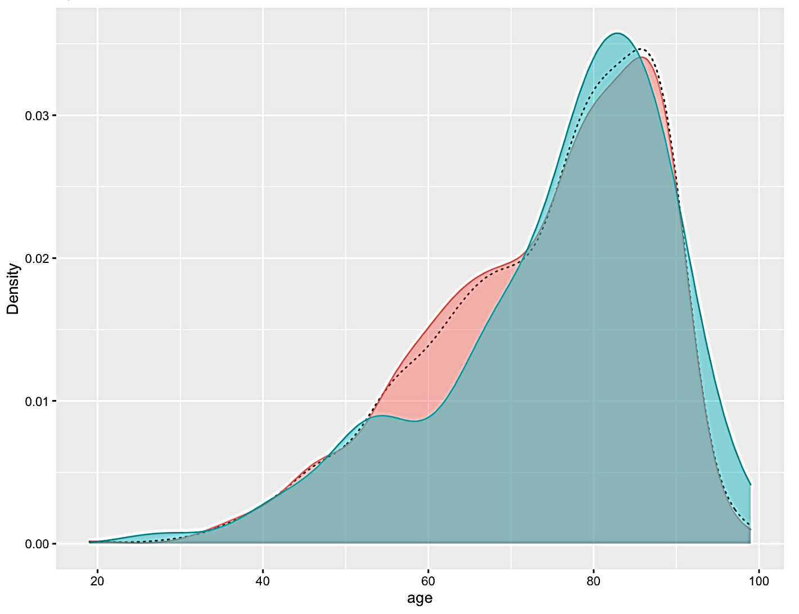
Age and Mortality Histogram
Ages from 70- to 90-year-olds would be more likely to be in the ICU for heart failure and have a higher risk of death
Blue= Death
Red= Survived

Slide 14
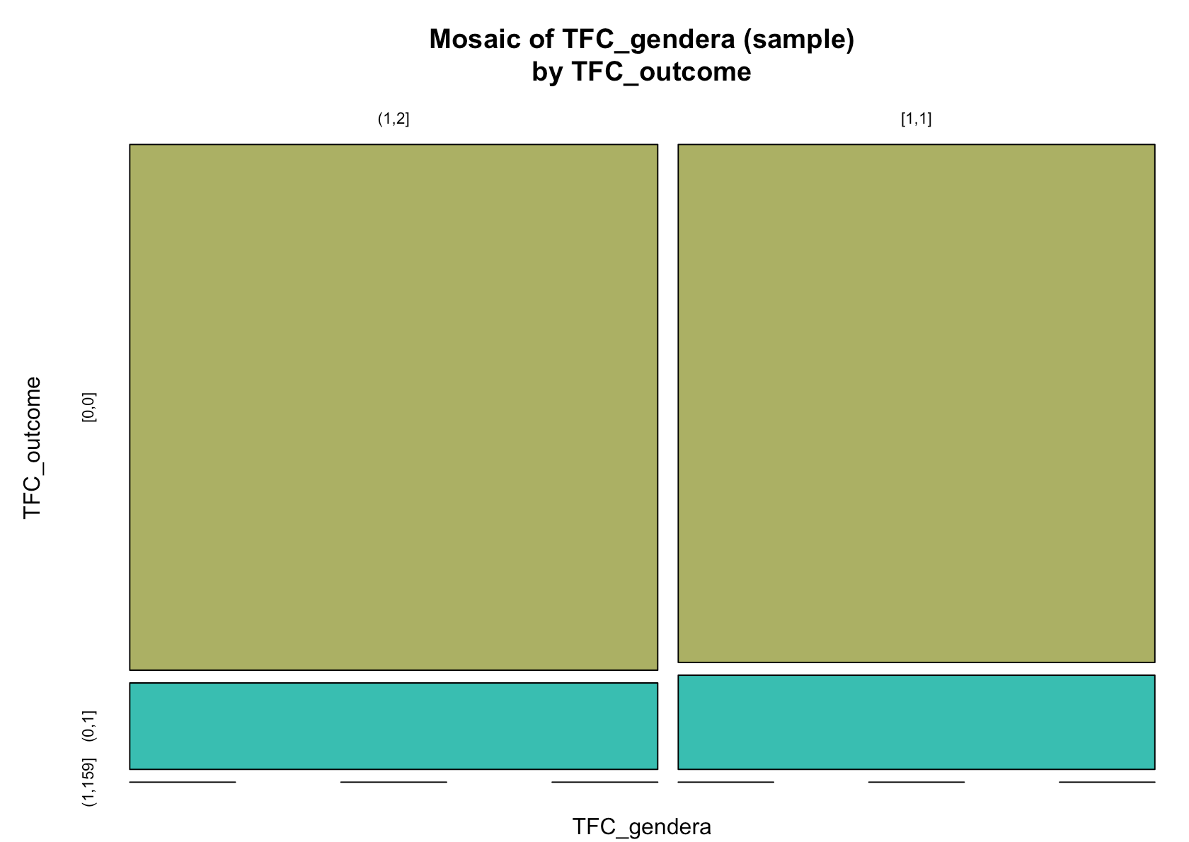
Gender and Mortality Outcome
Females have a slightly higher risk in morality than males when they are hospitalized for heart failure
Male
Female
Alive
Death

Slide 15
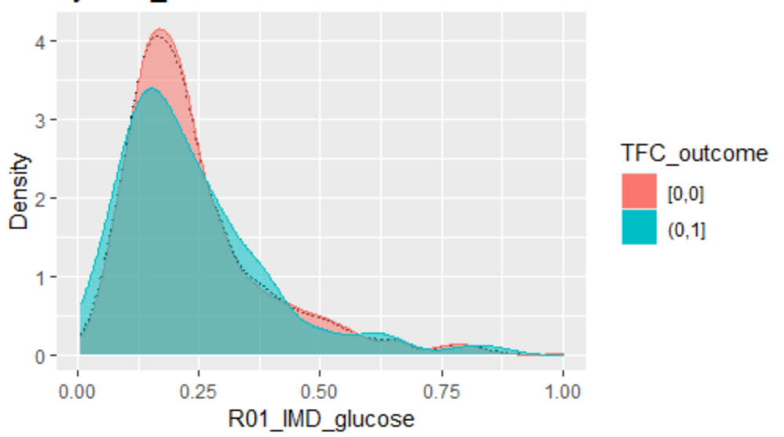
Glucose Levels and Mortality
Majority of patients with lower glucose levels have a decreased risk of death
[0,0], Red = Alive
[0,1], Blue= Death

Slide 16
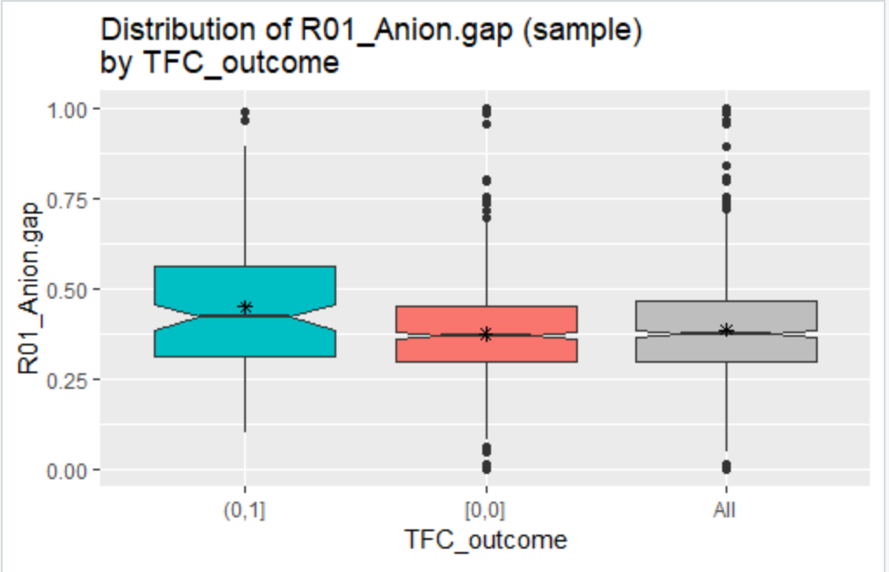
If the patient
had a higher anion gap, there was a higher chance of death.
Normal levels for anion gap are 3 to 10 mEq/L.
Anion gap= if too high or too low, it may be a sign of a disorder in your lungs, kidneys, or other organ systems.
Anion Gap and Mortality
GRAPH
Death
Alive

Slide 17


K-Means Clustering
2 Segments
Cluster 1
Size: 497
Male
Average Age: 67
More Likely to be Hypertensive
Not Diabetic
Not Likely to have Hyperlipemia or have renal failure
Cluster 2
Size: 472
Female
Average Age: 70
Less likely to be Hypertensive
Diabetic
More likely to have Hyperlipemia and have renal failure

Slide 18

Method and Evaluation

Slide 19
Models | Cross-Validated AUC
Gradient | 0.9280
Ada | 0.9264
Logistic Regression | 0.9315
SVM: Radial | 0.9056
SVM: Polynomial | 0.9202
Random Forest | 0.9352
ANN | 0.7779
Decision Tree | 0.8710
All Classification Models Logistic Regression, Decision Tree, SVM, Random Forest, AdaBoost, Gradient Boost and ANN.
Most Robust Evaluation AUC Robustness of AUC and Ease of Interpretation
Cross-Validation All models with random seeds 42

Slide 20
Recommendations
Increasing attention to patients with the following factors upon admittance to the ICU will lead to a decrease of in-hospital mortality rates:
Patient has Atrial Fibrillation
Increased Anion Gap
High Heart Rate
Increased Respiratory Rate
High BMI
Ages 70-90
Hypertensive (High Blood Pressure)
Patient is Diabetic

Slide 21
Next Steps
Data Gathering
Use long term data (only was collected for 24 hours)
Feature Selection
Select different features
Only used 15 out of 50 features
Increase Scope
Gather information on other leading causes of death
Gather data from more hospitals

Slide 22

Questions

Slide 23

Appendix

Slide 24
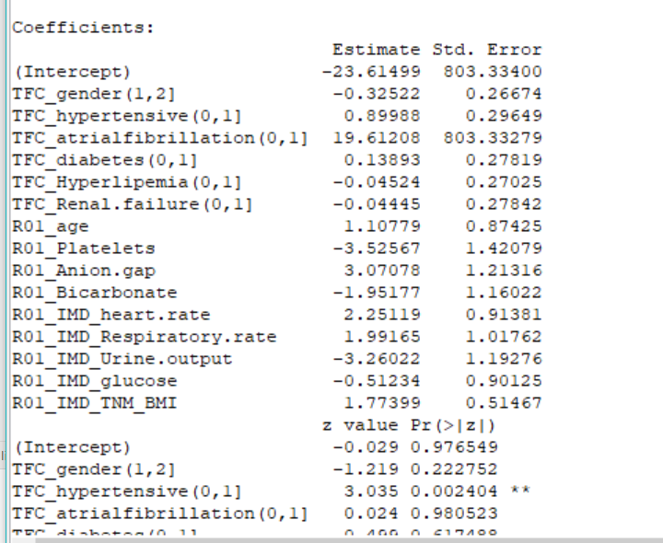
Logistic Regression Model

